Slide 1

Hackstreet Images
By: The Hackstreet Boys
Michael Hemmelgarn
Ivan Lavrov
Nick Nitta
Jalen Soat
Graham Tschieder

Slide 2
Introduction
Image Hosting Website
Started as website to create and store slideshows
Features:
Anonymous Usability
But limited
Password reset through email
Privacy Levels

Slide 3
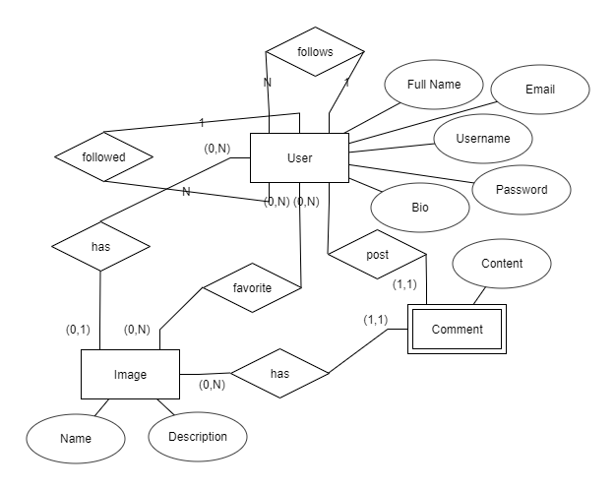
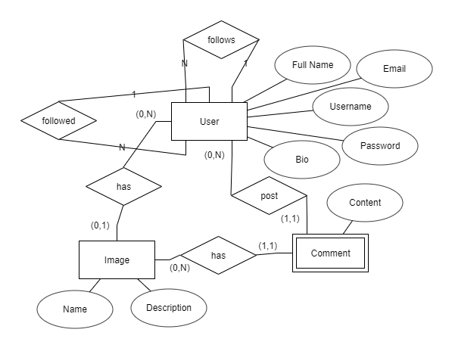
Entity Relationship Diagram

Slide 4
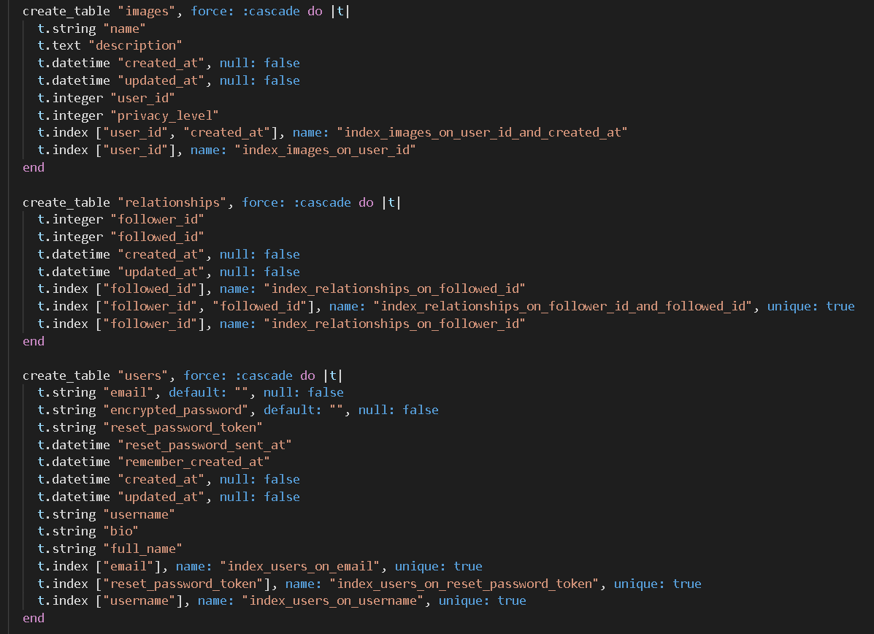
Schema

Slide 5
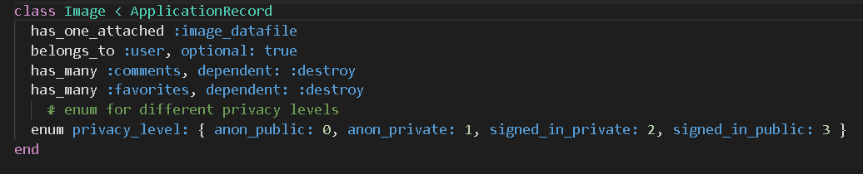
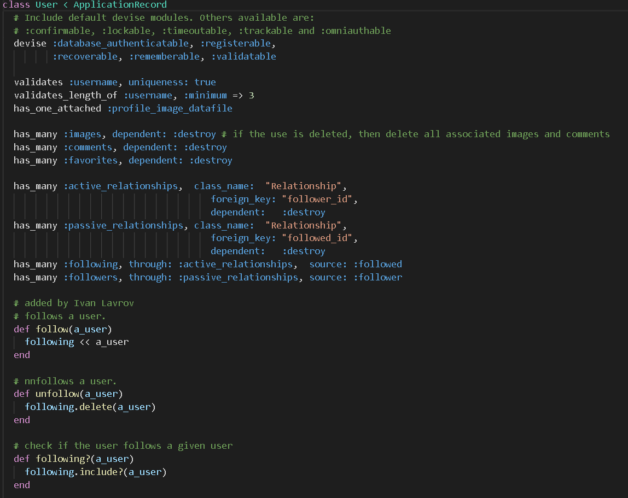
Models

Slide 6
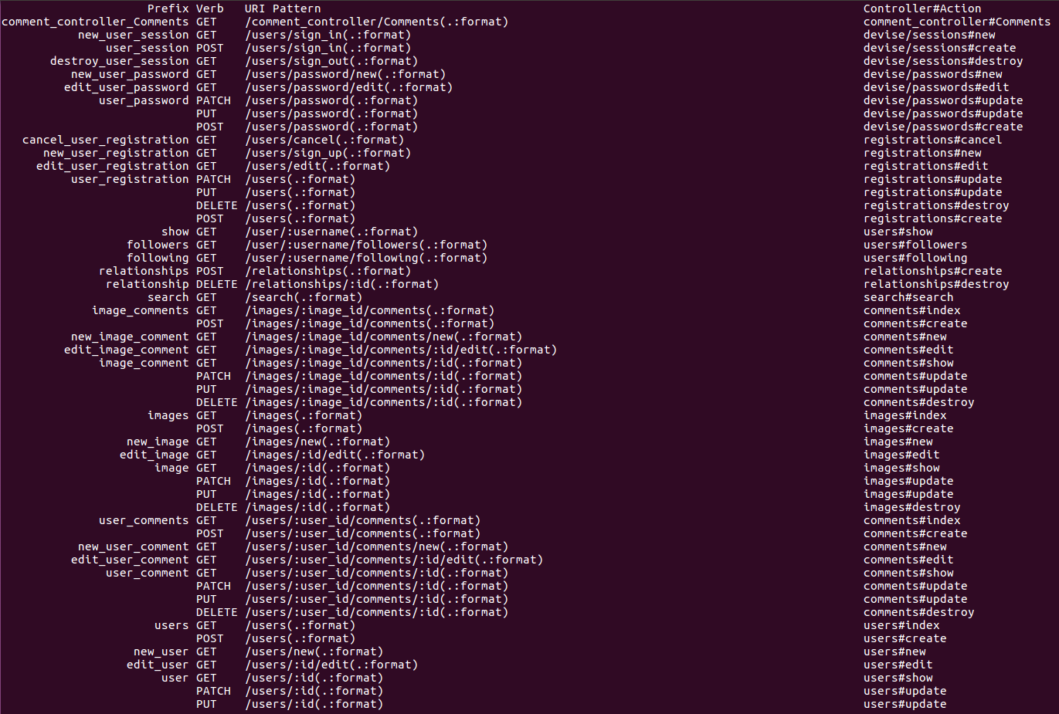
Routes

Slide 7
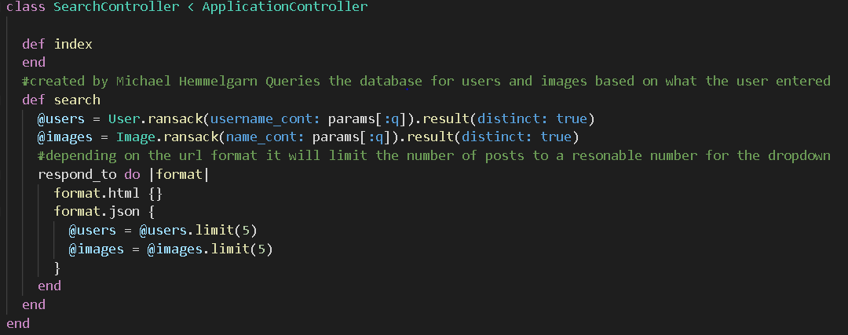
Interesting code - Search Bar

Slide 8
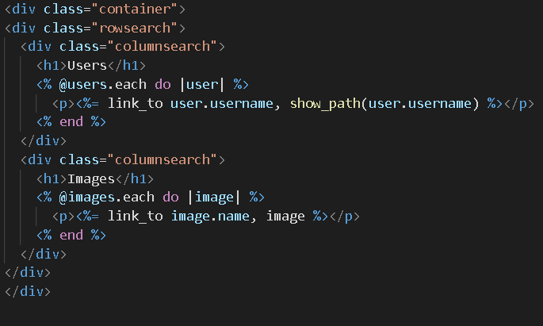
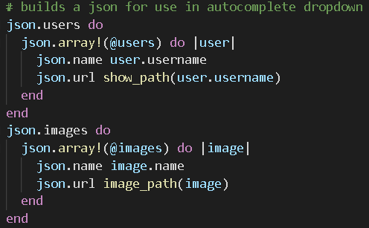
Search Bar View - Erb and Json
Erb
Json

Slide 9
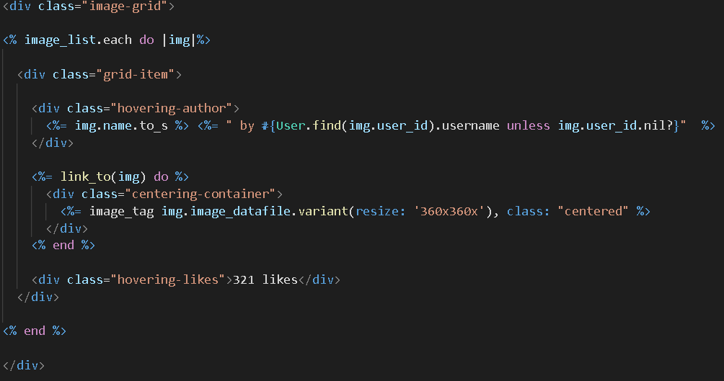
Search Grid Partial (_images_grid.html)

Slide 10
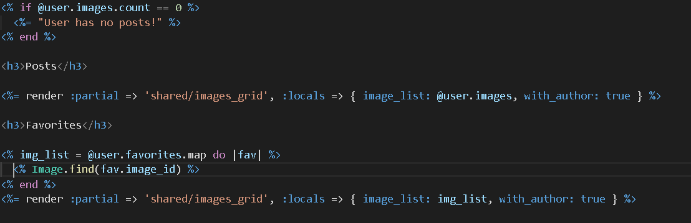
Grid Partial

Slide 11
Website Demonstration

Slide 12
Questions

